Slide 1

New MNRE Guidelines (IS 16270:2014) on Solar Batteries : Impact on India's Small and Medium Scale Battery Manufacturers
Sundar Mayavan, Ph.D.
Senior Scientist
Lead Acid Battery Group
CSIR- Central Electrochemical Research Institute
Karaikudi, INDIA

Slide 2
Presentation Outline
Introduction
About CSIR-CECRI
MNRE Guidelines
Importance of IS 16270 : 2014 Standard
Test Results of in-house developed LAB

Slide 3



CSIR-Central Electrochemical Research Institute
(A premier National R&D Lab in Electrochemistry)
Electrochemical Power Sources
Corrosion & Material Protection
Electrochemical Materials Science
Industrial Metal Finishing
Functional Materials
Electrochemical Process Engineering
Bio-sensors
Electrodics and catalysis
Groups - Electrochemical Power Sources
Polymer Electrolyte Fuel Cells
Lead Acid Batteries
Lithium Batteries
Redox Flow Batteries (Zn-Br)
Super Capacitors
LEAD ACID BATTERIES

Slide 4
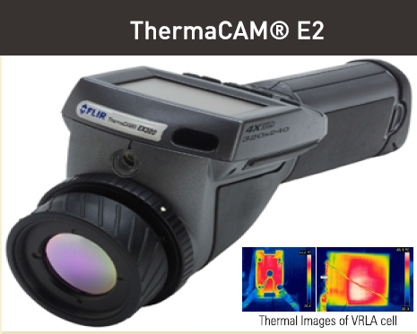
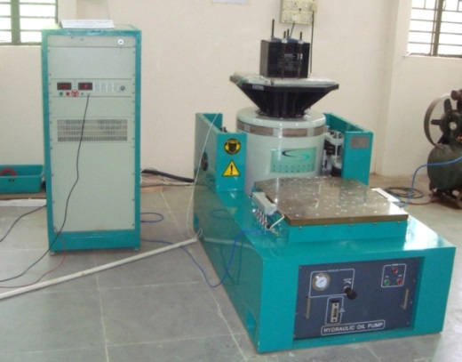
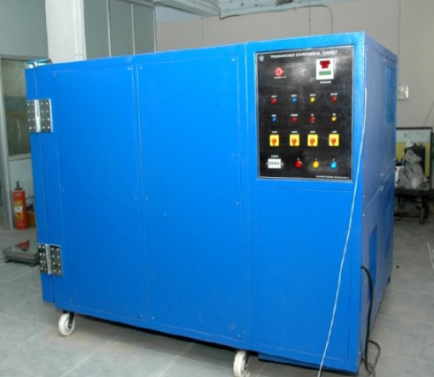
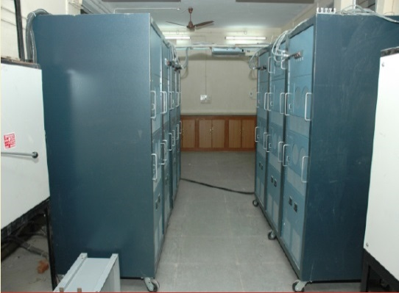
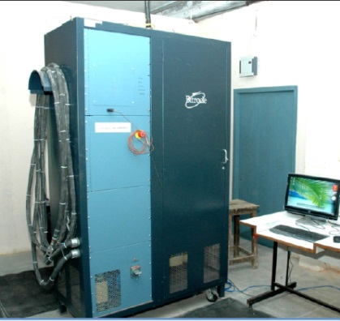
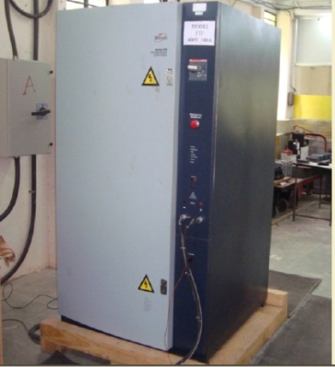
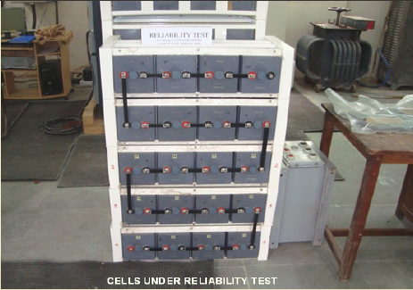
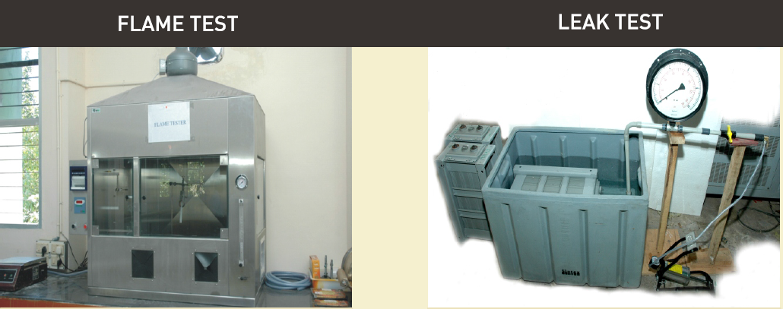
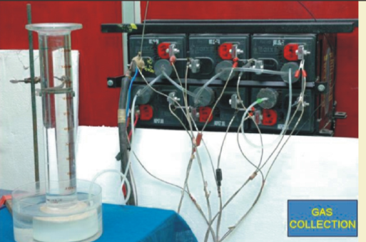
Battery Performance Testing & Evaluation Centre (BPTEC)

Slide 5

CSIR- Battery Performance Testing & Evaluation Centre (BPTEC) NABL Accredited
Accredited specification
LEAD ACID BATTERY @ BPTEC
IS 13369: 1992 (Tubular Positive)
IS 14257: 1995 (Motor Vehicles)
IS 1651:2013 (Tubular Positive)
IS 7372: 1995 (Motor Vehicles)
IS 15549 : 2005 (VRLA Stationary)
IRS 88/2004 (LM LAB Railways S&T)
IRS - S 93/96 (VRLA Indian Railways)
JIS C 8702-1: 2009 (Small sized VRLA)
NABL Accredited since 2014

Slide 6


BIS Recognized Laboratory
(under Laboratory recognition scheme)
Nodal Battery Test Lab for Solar PV Applications under MNRE
MNRE accredited Battery Testing facility (IS 16270 : 2014)
SECONDARY CELLS AND BATTERIES FOR SOLAR PHOTOVOLTAIC APPLICATION
— GENERAL REQUIREMENTS AND METHODS OF TEST
Member : MNRE & BIS Indian Battery Standard Drafting Committee (ETD 11)

Slide 7
What do we do to Industry?
Surface Area , Porosity
(Carbon /Active mass)
(Pore size/Pore Volume)
Structure – Property Correlation
BET/Mercury Porisometer
Particle Size/Morphology/Porosity
(Carbons / Active mass)
New Additive Evaluation
FE-SEM/TEM/HR-TEM
Structural Characterization
(Carbons/Active mass)
XRD/RAMAN/FTIR/XPS
Tear Down Analysis
Electrochemical Characterization
(HER/OER/Impedance/Polarization
Multi-Channel Poteniostat
Battery Failure Mechanism
Grid Alloy Composition
Optical ES/XRF

Slide 8
Major Select Customers
M/s LIVGUARD Batteries
M/s Duracell
M/s Indus Towers
M/s Exide
M/s Reliance Industries
M/s TVS Motors Hosur
M/s Enersys
Recognized Battery Test Facility for RDSO , MNRE and BIS

Slide 9





Solar LAB : Current Status in India
FLOODED
VRLA
GEL

Slide 10
Batteries in SPV Applications
Seasonal cycle : Summer
Periods with high solar irradiation
Can bring the battery to full charge / overcharge
Daily cycle
Charging during day/light hours
Discharging during night-time hours
Daily usage : 2-20 % of rated capacity
SoC Goes up
SoC Goes down
Seasonal cycle : Winter
Periods with low solar irradiation
The battery SoC can go < 20 % of rated capacity

Slide 11
Batteries in SPV Applications
Summer
The batteries will be operated at HRPSoC between (80 -100 %) of rated capacity
Winter
The energy produced by SPV may not be sufficient to fully recharge the battery.
SoC decreases and cycling takes place at low SoC
SPV Batteries are under Partial state of charge cyclic conditions
Summer : Batteries cycled @ High state of charge
Winter : Batteries cycled @ Low state of charge

Slide 12
MNRE guidelines - Batteries for SPV Application (Till 2018)
IS 13369: 1992 (Tubular Flooded Positive)
IS 15549 : 2005 (VRLA Stationary)
Endurance Test
Endurance Life Cycle
The batteries were immersed in a water bath maintained at 40±3°C and charged continuously at a current I = 0.1 x C10 amperes for periods of 2000 hours, as given below:
(a) 2- cycles of 300 h charging followed by test discharge
(b) 3- cycles of 200 h charging followed by test discharge
8- cycles of 100 h charging followed by test discharge
Requirement: The battery capacity shall not be less than 9 h of discharge at the final test discharge after the last period of charge.
Measure C3 capacity : Original Capacity
The batteries were immersed in a water bath maintained at 55 ± 3 °C
(a) Discharged for 3 hours @ I = 1.92 x C10 A
(b) Charge at constant voltage of 2.33 V with limit of 40 % of its rated capacity for duration of 9 hours.
Above step (a) and (b) shall be repeated 30 times.
This shall be treated as 1 life unit.
Requirement : Minimum 5 Life units before capacity falls below 80 % of its original C3 capacity.
The batteries are evaluated under Float conditions
The batteries are cycled under approx.50 % SoC
These specification do not reflect Batteries used in SPV applications

Slide 13
MNRE Guidelines 2019 for Solar Batteries
SECONDARY CELLS AND BATTERIES FOR SOLAR PHOTOVOLTAIC APPLICATION
— GENERAL REQUIREMENTS AND METHODS OF TEST
IS 16270 : 2014
Based on IEC 61427 : 2013

Slide 14
IS 16270 : 2014 - TEST METHODS
Table 1. Sequence of tests for Stationary Lead Acid Batteries
Sl. No. | Type Test | Clause No. | Cells
 |  |  | 1 | 2 | 3 | 4 | 5 | 6 | 7 | 8
1 | Physical Verification (Verification of Marking & Dimensions) | 4.2.1, 5.4 |  |  |  |  |  |  |  | 
2 | Capacity test @ C/10 Rate | 8.1 & 7.2 |  |  |  |  |  | 
3 | Endurance test (IS 13369/IS 15549) | 8.2 & 7.2 |  |  |  |  |  |  |  | 
4 | Charge Retention Test | 8.3 & 7.2 |  | 
5 | Cyclic Endurance in photovoltaic application | 8.4 |  |  |  | 
6 | Sulphation Test | 8.5 |  |  |  |  |  | 
7 | Water Loss Test | 8.6 & 7.2 |  | 
Cyclic Endurance in photovoltaic application

Slide 15
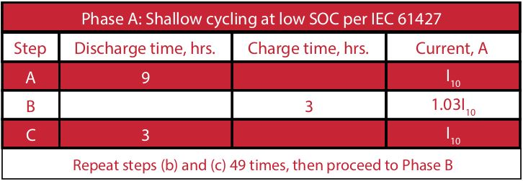
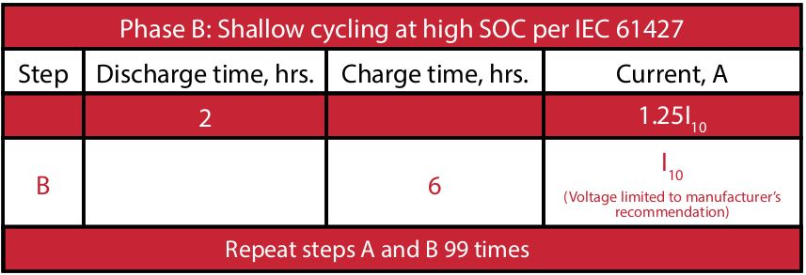
Cyclic Endurance : IS 16270 : 2014
Phase A: Shallow Cycling at Low State of Charge
Phase B: Shallow Cycling at High State of Charge
1 Life unit = A+ B = 150 Cycles
Requirement : 3 life units (450 Cycles)

Slide 16
Testing of LAB as per IS 16270:2014
Tubular Positive 12 V / 150 Ah Flooded LAB were selected for testing.
The battery were manufactured at MSME unit in Calicut “JAS Batteries.”
Role of Carbon on Battery Performance was studied.
S. No | Type of carbon | Surface Area | Supplier
1 | Carbon black | 62.5 m²/g | Philips Carbon
2 | High surface area carbon (HSA) | 1236 m²/g | PBX 51-Cabot
3 | MWCNT | - | SRL
Cyclic Endurance : as per IS 16270:2014
Life cycle Endurance : as per IS 13369

Slide 17
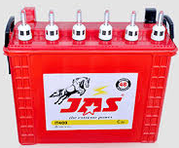
Flooded LAB Cyclic Endurance Test (12 V / 150 Ah)
LAB 1
LAB 2
LAB 3
Carbon Black
Philips Carbon
(0.2 wt %)
MWCNT
(0.1 wt %)
HSA Carbon
(0.1 wt %)
Effect of Carbon : Change only in “CARBON”

Slide 18
CYCLIC ENDURANCE as per IS 16270 : 2014

Slide 19
Test Protocol : Cyclic Endurance (12 V / 150 Ah)
Phase A: Shallow Cycling at Low State of Charge
(135 Ah)
(15 A)
(45 Ah)
(15 A)
Phase B: Shallow Cycling at High State of Charge
(37.5 Ah)

Slide 20
Cyclic Endurance Results of LAB as per IS 16270 : 2014
Flooded Tubular LAB : 12 V / 150 Ah
Life unit | Phase A + Phase B Cycles | LAB 1 (CB) C/10 Ah | LAB 2 (CNT) C/10 Ah | LAB 3 (HSA) C/10 Ah
1 | 150 | 177 | 172 | 174
2 | 300 | 172 | 169 | 170
3 | 450 | 168 | 166 | 165
4 | 600 | 157 | 155 | 157
5 | 750 | 155 | 154 | 153
6 | 900 | 140.1 | 142.3 | 143.0
IS / IEC Service life for Tubular Flooded LAB vs Trojan (9 Cycles)
Battery Type | Equivalent Service Life
Flooded Tubular LAB | 6 Years (900 cycles)
Requirement : 3 units (450 cycles)

Slide 21
ENDURANCE TEST AS PER IS 13369:1992

Slide 22
Endurance Test as per IS 16270 / IS 13369 : 92
The batteries were immersed in a water bath maintained at 40±3°C and charged continuously at a current
I = 0.1 x C10 amperes for periods of 2000 hours, as given below:
(a) 2- cycles of 300 h charging followed by test discharge
(b) 3- cycles of 200 h charging followed by test discharge
8- cycles of 100 h charging followed by test discharge
Requirement: The battery capacity shall not be less than 9 h of discharge at the final test discharge after the last period of charge.
LAB 1
LAB 2
Carbon Black
Philips Carbon
(0.2 wt %)
HSA Carbon
(0.1 wt %)

Slide 23
LAB Comparison : Endurance as per IS 13369 : 92
Figure (a) Discharge time of LAB 1 and LAB 2 at C/10 rate, (b) capacity of LAB 1, and LAB 2 under endurance test conditions.

Slide 24
Concluding remarks
MNRE has made IS 16270 : 2013 as a mandatory specification for SPV Batteries (VRLA/GEL/Flooded/Lithium (will be included shortly).
Cyclic Endurance mimics battery operation in SPV applications.
Flooded Tubular Battery (12 V/150 Ah) with 3 CARBON ADDITIVES were tested
for cyclic endurance as per IS 16270.
All 3 batteries have completed 6 cycles (Requirement : 3 life unit).
Carbon does not have a crucial role under our tested conditions. MSME / Small Manufacturers no need to PANIC about new guidelines as both cyclic endurance & life cycle endurance requirements shall be met with Carbon Black itself (Philips Carbon)
No need to go for special carbons as far as Solar Application is concerned

Slide 25
New Testing Facility for Lead Acid Batteries & Lithium Batteries
Budget : 14 Crore
Functional from : August 2020
OES , BET, Mercury Porisometer, Battery Cycler ( 50 Channels)
Focus on……
E-Rickshaw
Telecom
Solar Applications
Lithium Battery Testing

Slide 26
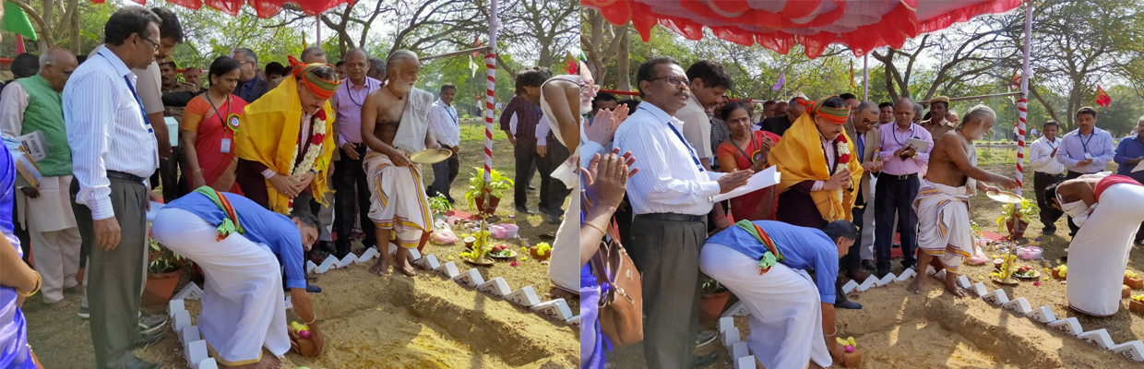
Lithium Battery Fabrication Facility @ CSIR-CECRI
Hon’ble Science & Technology Minister Dr. Harsh Vardhan laying the foundation stone
for 100 Crore Lithium Battery Pilot Plant @ CECRI Chennai Unit
Pilot Plant Capacity : 1000 cells/Day
Type: Prismatic & Cylindrical Cells

Slide 27
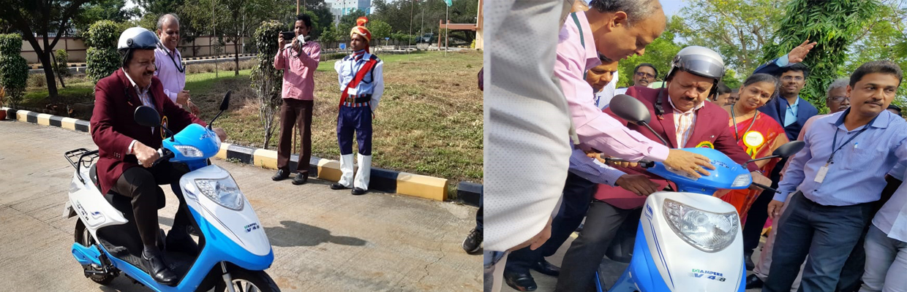
Demo of CECRI developed Lithium Ion Battery Powered 2-Wheeler

Slide 28

Acknowledgement
Director CSIR – CECRI
HOD - ECPS
Technical Officers
Mr. P. Seenichamy
Mr. V. Muthumani
Mr. S. Sekar
Project Assistants
Mr. Arul
Mr. Saravanakumar
Mr. Vasanth
Mr. Uday Venkat Kiran
Ph.D. Scholars
Mr. Mithin Kumar
Mr. Arun
Mr. JIJO CHERIAN of JAS Batteries Calicut

Slide 29
THANK YOU

